Slide 1

ZooMu PC Workshop: Roadmapping

Slide 2
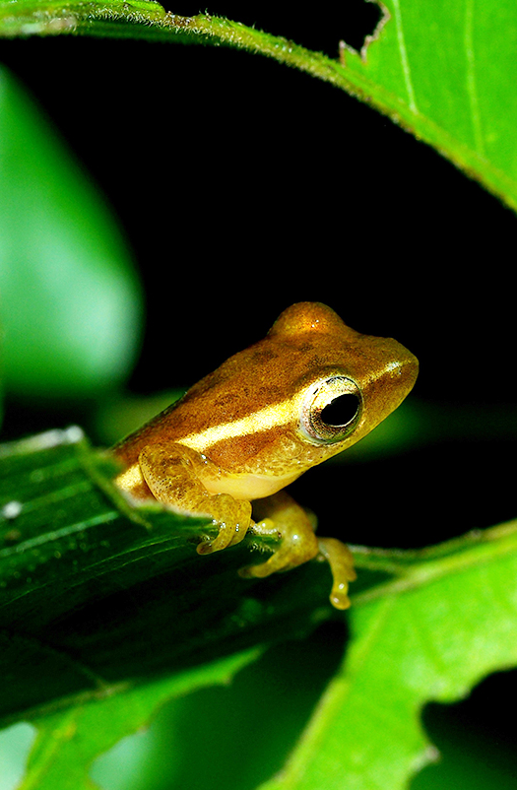
Agenda
Introduction (10 min)
Breakout Group Discussion (60 min)
Consolidation
Read-thru (10 min)
Block-by-Block (40min)

Slide 3
How to get there
In an ideal world…
A robust network of zoos/aquariums and natural history museums
Each Z/A as 5 NHM partners; each NHM has 5 Z/A partners
Specimen transfer Z/A → NHMs becomes standard procedure
Identify priorities for the ZooMu Physical Collections Working Group
Guide future goals for the ZooMu Network

Slide 4
Breakout Group Discussion
 | Year 1 | Year 2 | Year 3 | Year 10
What
Who
How

Slide 5
Consolidation
Read-thru
Overall understanding of bigger picture
Block-by-Block
Distill 1-2 points per section

